Slide 1
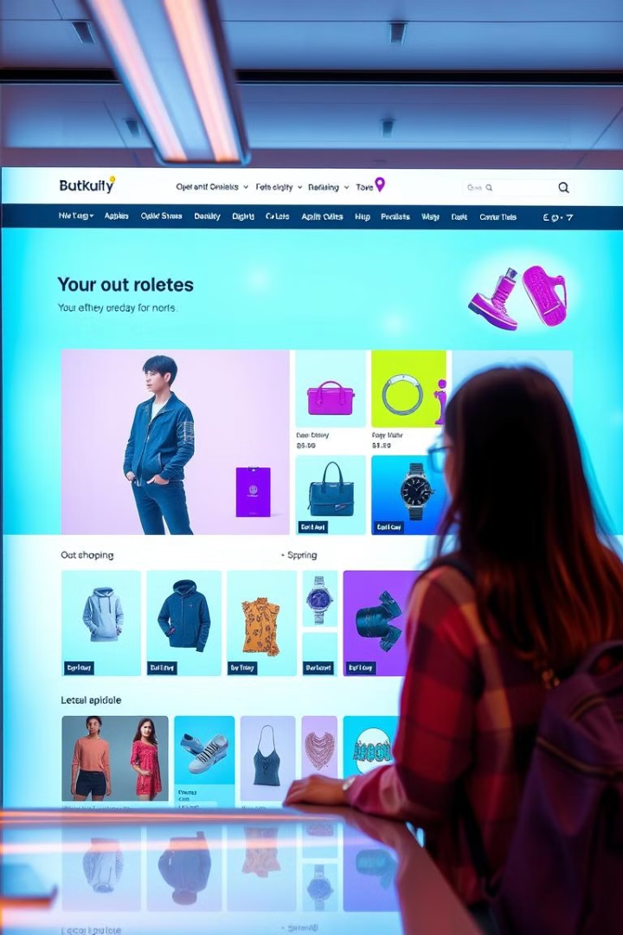
Ecommerce Customer Segmentation and Prediction

Slide 2
Understanding the Problem Statement and the Data
Problem
Data
Identify and understand the key business objectives for this project. What is the business trying to achieve with customer segmentation and prediction? What are the expected outcomes?
Understand the data available for analysis. What are the features, data types, and relationships within the dataset? Identify any potential data quality issues.

Slide 3
Table Of Content
1
Data Gathering and Data
2
Data Preprocessing
3
Exploratory Data Analysis
4
Featuring Engineering
5
Customer Segmentation
6
Model Training and Predicting
7
Result and performance Analysis
8
Conclusion

Slide 4

Data Cleaning and Preprocessing
1
Missing Values
2
Outliers
Handle missing values using techniques like imputation or removal, depending on the nature of the data and the extent of missing values.
Identify and address outliers using methods like z-score or IQR, ensuring data integrity and accuracy.
3
Feature Transformation
Transform features as needed using techniques like standardization or normalization to improve model performance

Slide 5
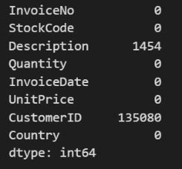
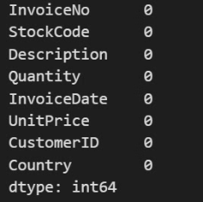
Handling Missing Values
Null values in Feature Description - 1454 Customer Id - 135080
After Handling
Before Handling
I removed Null values for upgrade data quality

Slide 6
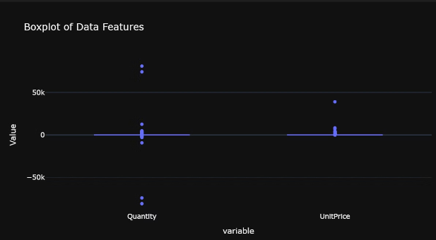
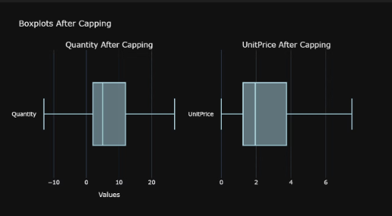
Outlier Treatment
I checked outlier in dataset and show with box plot
method of remove outlier
1) Z-Score Method
2) IQR Method
I choose IQR method in this project to remove outliers
I have outlier in Quantity and Unit Price which i remove using IQR method
Before Outlier Treatment
After Outlier Treatment

Slide 7




Exploratory Data Analysis (EDA)
Descriptive Statistics
Correlations
Calculate basic statistics like mean, median, mode, and standard deviation to understand data distribution.
Analyze relationships between features using correlation analysis to identify key dependencies and patterns.
Visualizations
Create histograms, scatter plots, box plots, and other visualizations to gain insights into data patterns and trends.

Slide 8

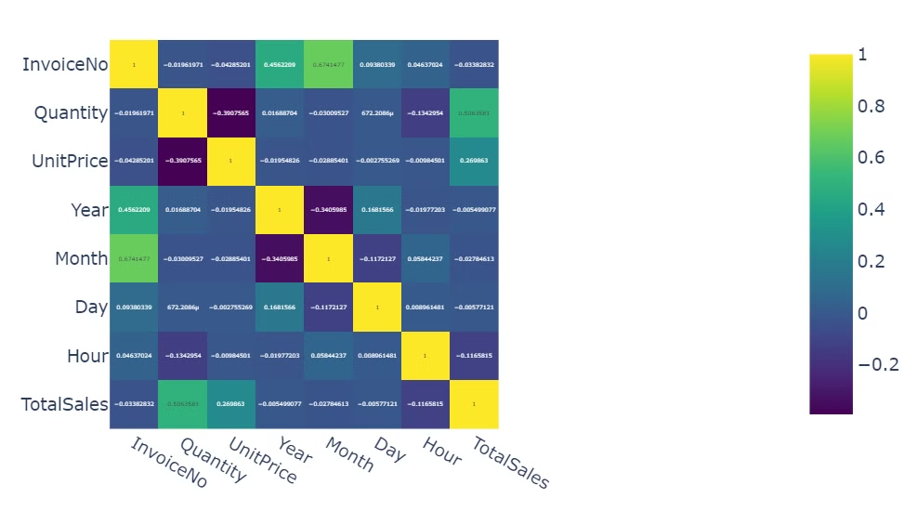
heatmap
This heatmap shows the correlation between key numeric variables in the dataset. Strong positive correlations (yellow) and negative correlations (purple) are highlighted. Notably, Quantity and TotalSales have a high positive correlation, while UnitPrice shows weak relationships with other variables. These insights guide feature selection for model development.

Slide 9

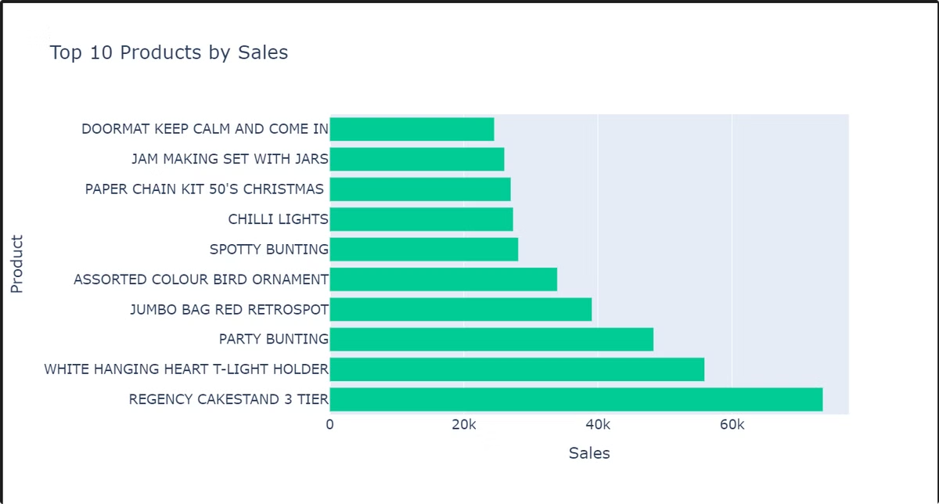
Top 10 product by sales
This bar chart highlights the top 10 products by total sales. The highest-selling product is the "Regency Cake Stand 3 Tier," followed by the "White Hanging Heart T-Light Holder" and "Party Bunting." These insights provide a clear understanding of the best-performing products, enabling the company to prioritize stock and marketing efforts for these items.

Slide 10

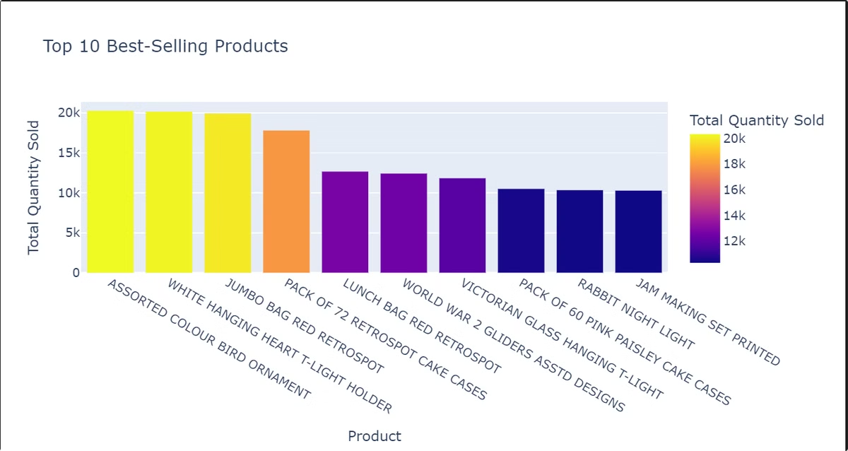
Top 10 Selling Product By Quantity
"The chart displays the top 10 best-selling products, with assorted color bird ornaments leading in sales followed by white hanging heart t-light holder."
Highlighting Top Sellers:
"Assorted color bird ornaments and white hanging heart t-light holders emerge as the top two best-selling products, showcasing strong customer demand."

Slide 11

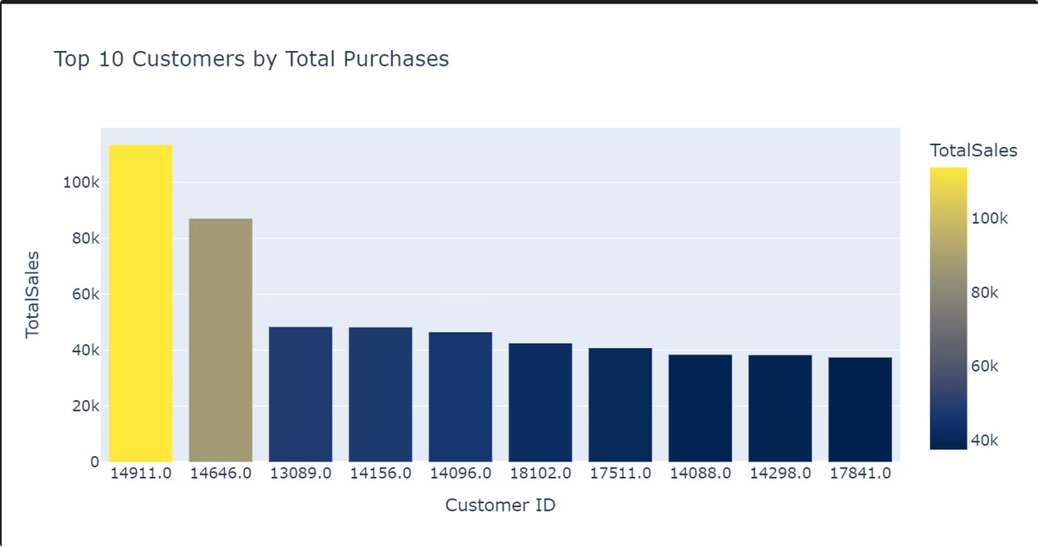
Top 10 Customer By Purchase
Concise & Informative:
"Customer ID 14911.0 stands out as the top customer with the highest total sales, followed by Customer ID 14646.0."
Highlighting Top Customers:
"Customer IDs 14911.0 and 14646.0 are the top two customers based on total purchases, indicating their significant contribution to overall sales."

Slide 12

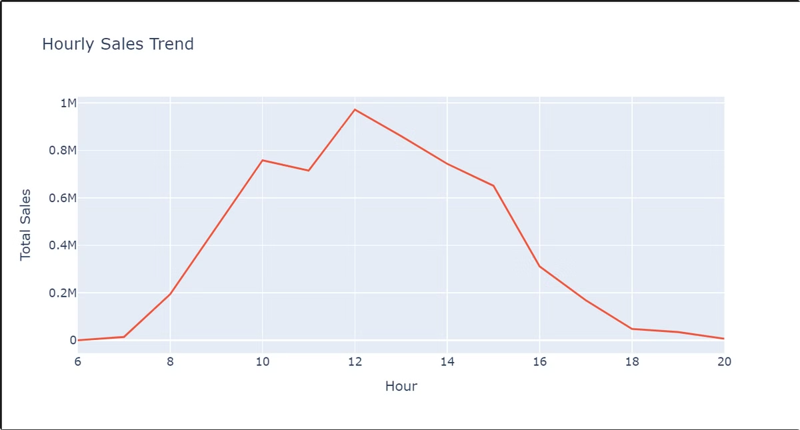
Hourly trend sales
Midday Surge: Sales peak between 11 AM and 1 PM.
Morning Momentum: Sales steadily rise from 6 AM to 1 PM.
Sharp Afternoon Drop: Sales decline significantly after 1 PM.
Low Evening Sales: Sales remain low from 4 PM onward.
These descriptions are more concise and suitable for a presentation. Let me know if you'd like any modifications!

Slide 13

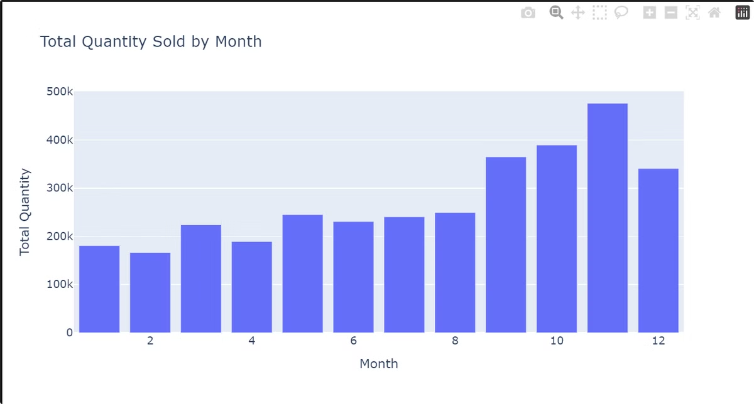
Quantity sold by month
Sales Momentum Builds Throughout the Year, Culminating in a Strong Q4: The graph demonstrates a consistent increase in sales quantity throughout the year, with a significant peak in the final quarter, particularly in December.
December Dominates with Peak Sales: The graph highlights December as the month with the highest sales volume, indicating a strong demand during the year-end period.

Slide 14

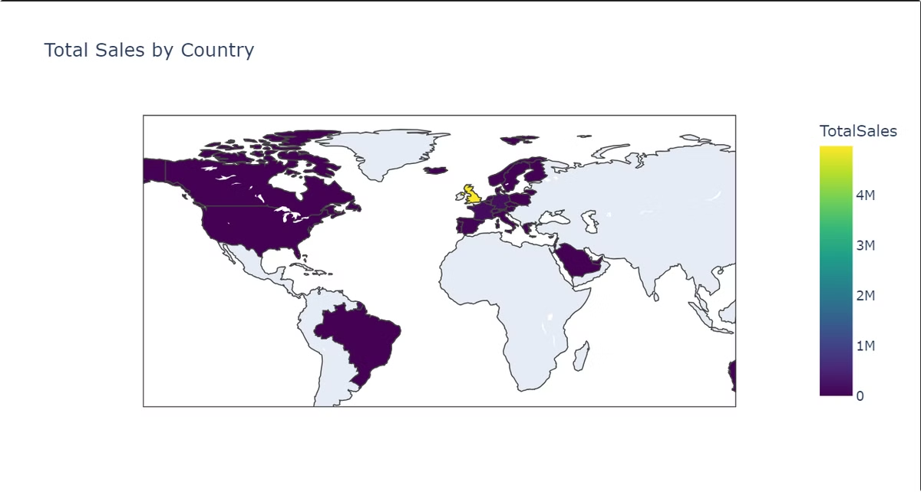
sales by country
Here is a short description for the "Total Sales by Country" map:
"Sales are concentrated in North America and Western Europe."
This concise statement effectively summarizes the key takeaway from the map.

Slide 15

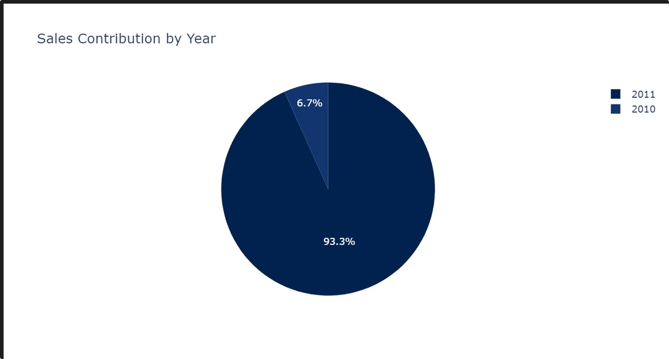
Sales contribution by year
"In 2011, sales represented 6.7% of the total, while 2010 accounted for a substantial 93.3%."
Highlighting 2010's Dominance:
"The chart reveals that 2010 was a dominant year for sales, contributing 93.3% to the total, compared to 6.7% for 2011."

Slide 16



Feature Engineering
Feature Selection
1
Identify the most relevant features for segmentation and prediction, considering factors like importance and predictive power.
Feature Extraction
2
Create new features from existing ones using techniques
Feature Transformation
3
Apply transformations like binning or one-hot encoding to prepare features for machine learning algorithms.

Slide 17
This RFM analysis helps understand customer behavior:
Recency: Days since the last purchase to measure engagement.
Frequency: Number of transactions to gauge loyalty.
Monetary: Total spending to identify high-value customers.
Additional metrics like AOV (Average Order Value), Product Variety, Returns, and Lifetime Value (LTV) provide deeper insights for targeted marketing and customer retention strategies.

Slide 18

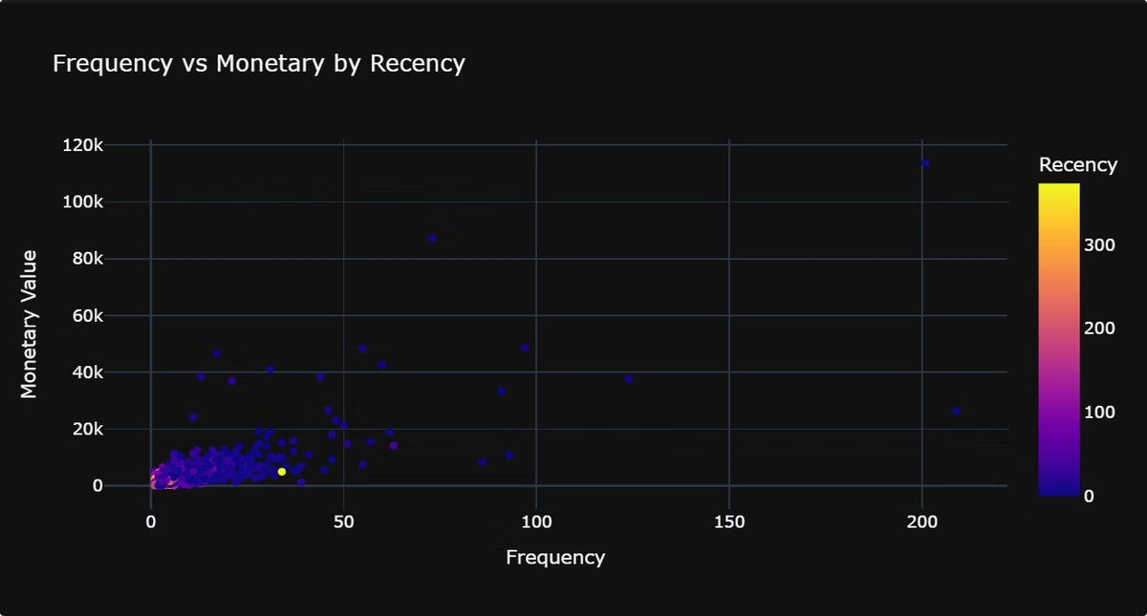
Recency vs Frequency vs Monetary
Concise & Informative:
"The scatterplot shows the relationship between customer frequency, monetary value, and recency. Customers with higher recency tend to have higher monetary values."
Highlighting Key Trends:
"The plot reveals a positive correlation between recency and monetary value, suggesting that customers who have recently made purchases tend to spend more."

Slide 19
Customer Segmentation
Clustering
1
Apply unsupervised learning algorithms like k-means or hierarchical clustering to group customers based on similarities.
Segmentation Criteria
2
Choose criteria based on business objectives, such as purchase history, demographics, or behavioral patterns.
Segment Analysis
3
Analyze each segment to understand their unique characteristics, preferences, and potential value to the business.

Slide 20
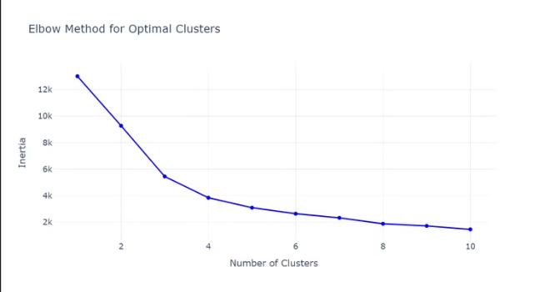
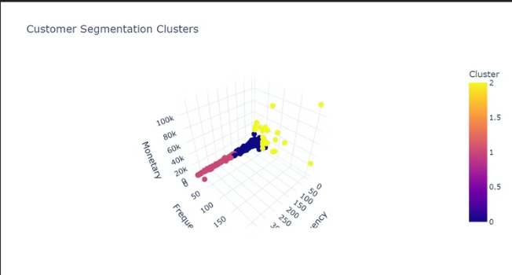
Optimizing K-Means Clustering: The Elbow Method
The Elbow method helps determine the optimal number of clusters (K) in K-Means clustering. It plots the Within-Cluster Sum of Squares (WCSS) against the number of clusters. The "elbow" point, where the rate of decrease in WCSS significantly slows down, suggests the optimal K.

Slide 21
Predicting Model and Training
Random Forest
1
Ensemble learning algorithm that combines multiple decision trees to improve prediction accuracy and reduce overfitting.
2
SVM
Supervised learning algorithm that finds the optimal hyperplane to separate data points into different classes, suitable for high-dimensional data.
LightGBM
3
Gradient boosting algorithm that uses decision trees to make predictions, known for its speed and performance.
4
MLP
Neural network algorithm with multiple layers of interconnected nodes, capable of learning complex relationships in data.
KNN
5
Lazy learning algorithm that classifies data points based on their nearest neighbors, suitable for non-linear relationships.
6
XGBoost
Gradient boosting algorithm that uses decision trees to make predictions, known for its performance and ability to handle large datasets.

Slide 22

Random Forest
Strengths
Robust to outliers and noise. Can handle high-dimensional data. Effective for both classification and regression tasks.
Limitations
Can be computationally expensive for very large datasets. May struggle with complex interactions between features.

Slide 23
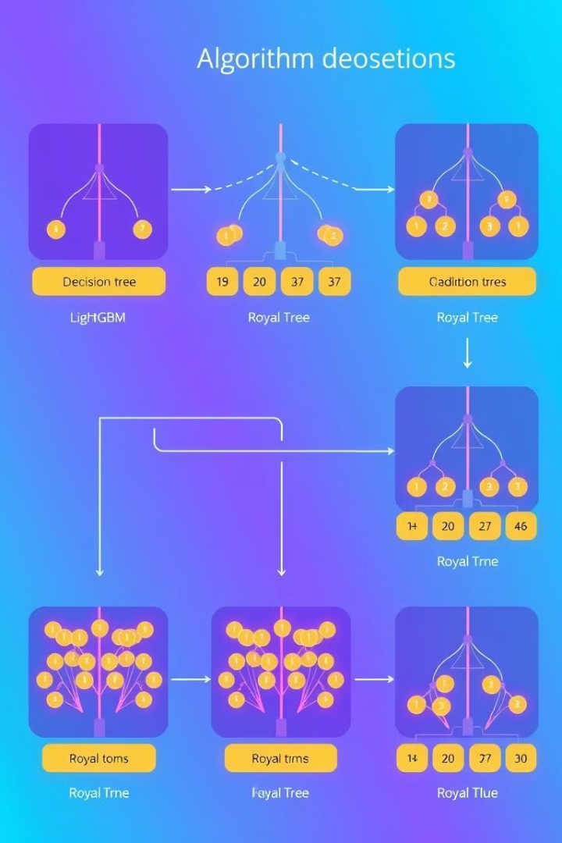
LightGBM
Strengths
Limitations
Fast training speed. Handles large datasets efficiently. Effective for both classification and regression tasks.
May overfit if not carefully tuned. Can be sensitive to hyperparameter choices.

Slide 24

XGBoost
Gradient boosting algorithm that utilizes decision trees to make predictions. It's known for its performance and ability to handle large datasets.

Slide 25

K-Nearest Neighbors (KNN)
KNN is a supervised learning algorithm that classifies data points based on their nearest neighbors. It's suitable for non-linear relationships. KNN is a simple and intuitive algorithm, but can be computationally expensive for large datasets.

Slide 26



SVM
Strengths
Excellent for high-dimensional data. Effective for both classification and regression tasks. Can handle non-linear relationships.
Limitations
Sensitive to the choice of kernel function. Can be computationally expensive for very large datasets.

Slide 27

Multi Layer Perceptron (MLP) Model
Strengths
Limitations
Versatile and can handle complex relationships. Can be used for both classification and regression.
Requires large datasets for training. Prone to overfitting if not carefully tuned.

Slide 28
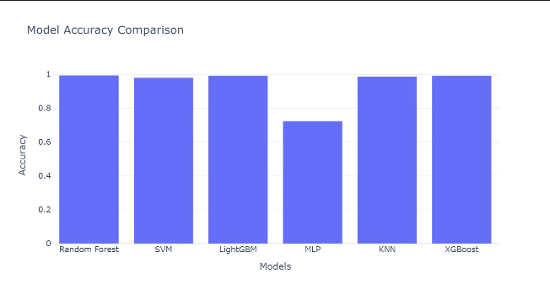
Model Accuracy Comparison

Slide 29
Result And Performance Analysis
Model
Accuracy
Precision
Recall
F1 Score
Random Forest
0.994878
0.994892
0.994878
0.994669
LightGBM
0.993598
0.993646
0.993598
0.993603
XGBoost
0.993598
0.993606
0.993598
0.993600
KNN
0.988476
0.987992
0.988476
0.988057
SVM
0.980794
0.972098
0.980794
0.976355
MLP
0.724712
0.525207
0.724712
0.609038

Slide 30

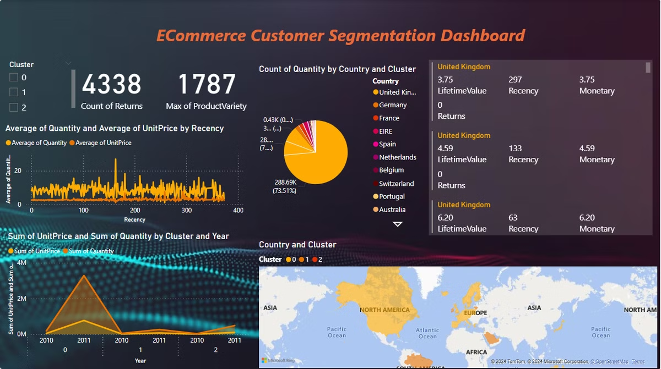
Dashboard for analysis

Slide 31
conclusion
This project successfully developed a customer segmentation model and predictive classifier, providing valuable insights into purchasing patterns. Key customer segments were identified, enabling targeted marketing and improved retention strategies.
Impact:
Focused efforts on high-value customers.
Personalized marketing to boost satisfaction and loyalty.
Enhanced inventory management and resource allocation.
These insights empower the e-commerce company to optimize operations, improve customer relationships, and drive business growth.

Slide 32
Thank You

